Slide 1




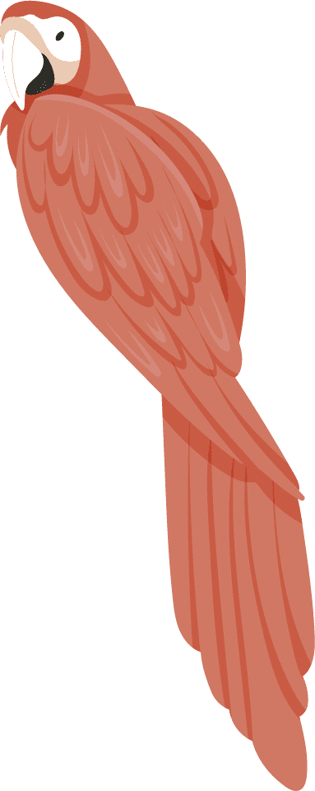







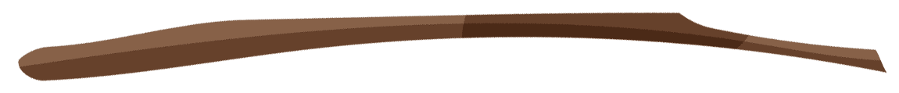

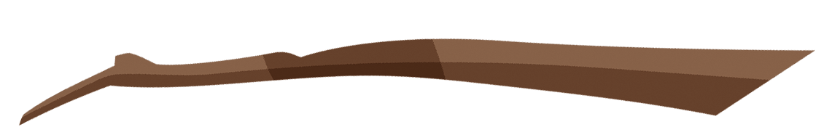





AUckland Zoo
Capstone - IOD Software Engineering
Notes:
Kia Ora everyone and thank you for coming.

Slide 2







Overview
An interactive and educational website for the Auckland Zoo Education team
Notes:
A brief overview on my capstone projects is that I have created an interactive and educational website for the Auckland Zoo Education team.

Slide 3


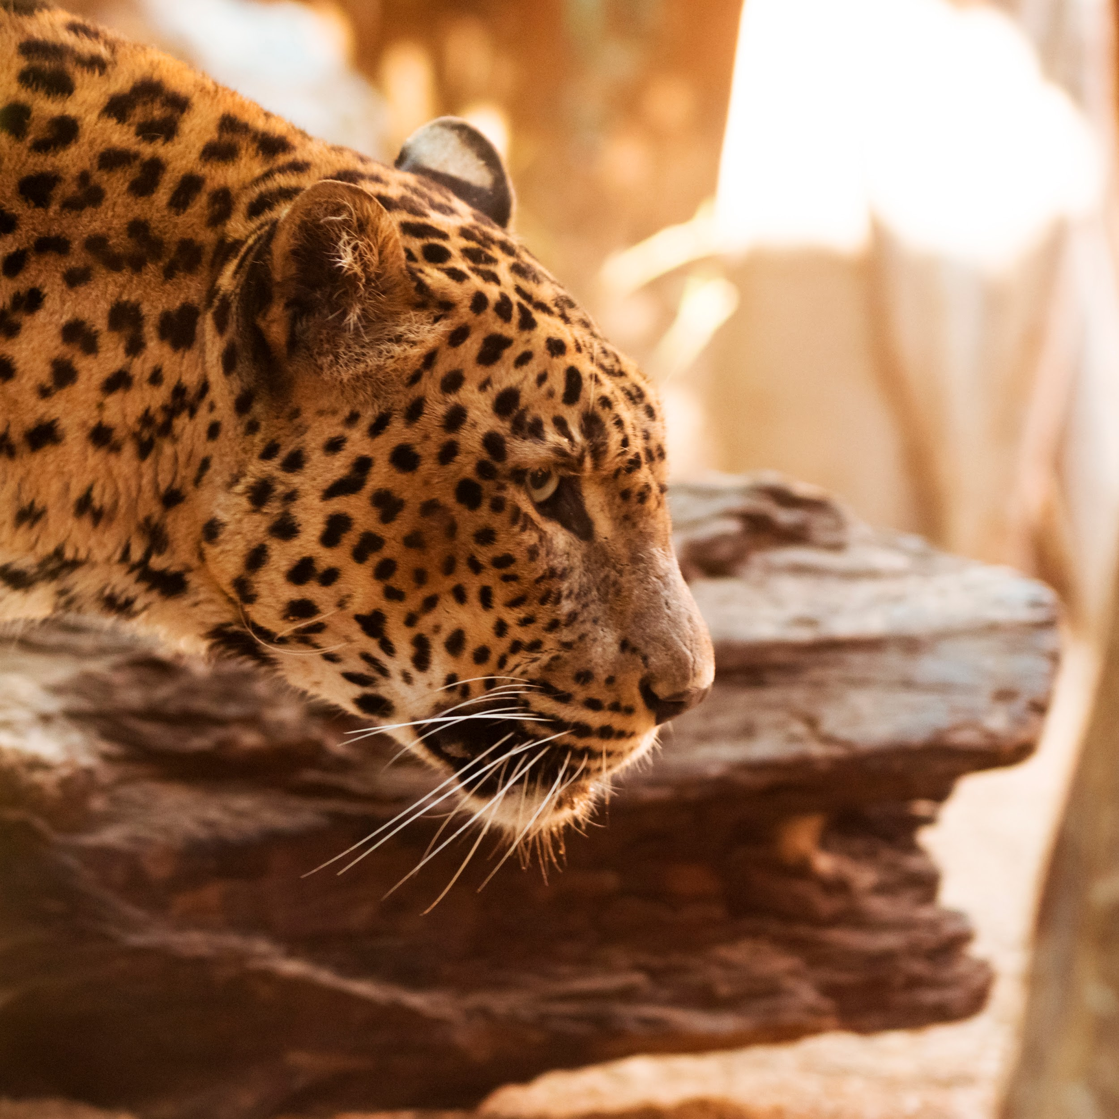

Why is it important?
A captivating and educational website for the education department of Auckland Zoo to ensure that the learning doesn’t just stop after the session!
Notes:
A friend from the Education department at Auckland Zoo approached me regarding the development of an Education website. The website is intended for use during teaching sessions and to provide classes and students with further exploration options after their visit. The main focus is to make the website captivating and enjoyable. The goal is to create an engaging online platform that maintains students' interest and motivation to continue learning even after their session with the education team ends.

Slide 4

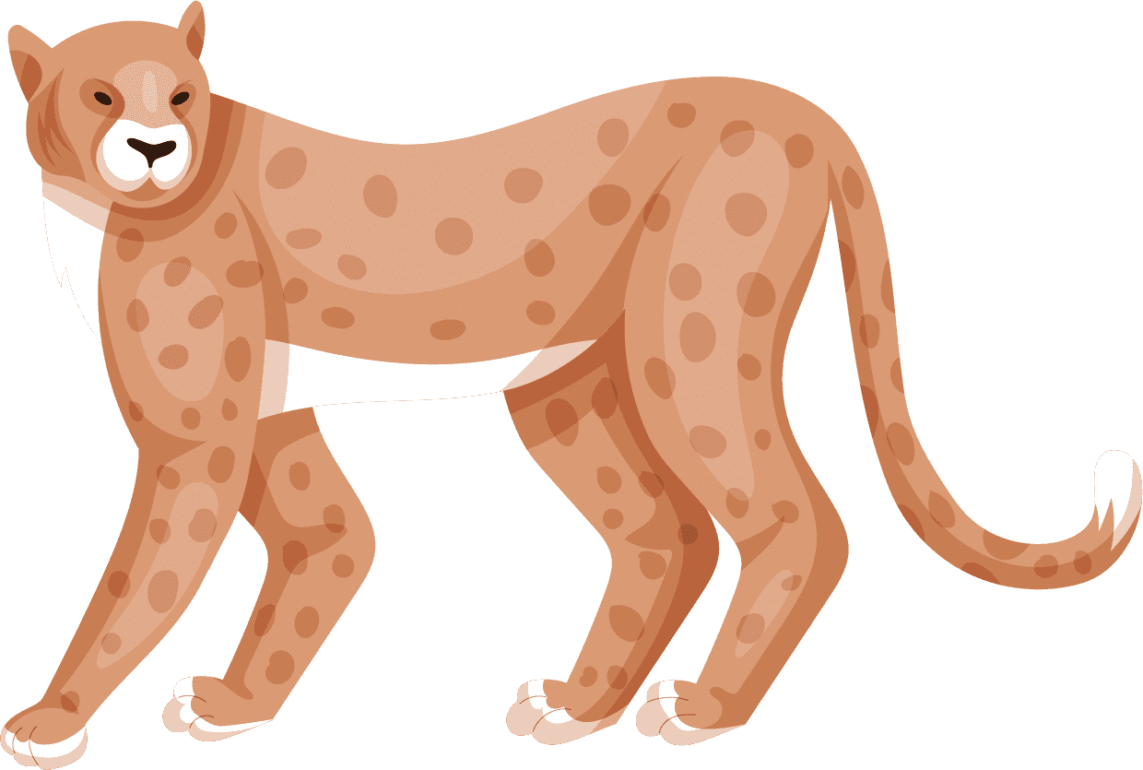
RESEARCH
Zoo Websites
Viewed multiple zoo websites and their education sections.
Singapore Zoo
Bronx Zoo
GSAP Showcase
Showcase section to view projects/websites that have utilised GSAP! This helped me research interactive and interesting styles that I could utilise!
Notes:
When researching the design and interactive components for my website, I explored various zoo websites such as the Singapore and Bronx Zoo. I focused particularly on their education sections to understand how they are structured. I noticed a common grid layout among these websites, but there was limited information about the education team and their offerings. Despite this, I was impressed by the vibrant colors and illustrations on the Singapore Zoo homepage. They created a fun and captivating experience that evoked warm, happy feelings. I aimed to replicate this emotional response for users visiting my website.
To enhance the interactivity of my website, I turned to GSAP, a JavaScript animation library. Browsing through the "Showcase" section on the GSAP website, I explored projects from other creators who had incorporated GSAP animations into their websites. Seeing these animations in action helped me visualize how users would interact with scroll-based elements and inspired ideas for integrating similar features into my own project.

Slide 5




TIMELINE
FRontEnd
Connection
Building my website and implementing CSS
Connecting my frontend to backend
Design
Backend
Documentation
Illustration, Mockups and Charts
API, Database and CRUD
Github, Presentation and remaining documents
Notes:
To effectively manage the remaining time for my capstone project, I created a detailed timeline. I began by focusing on the front-end aspects of the project, including creating illustrations, a mermaid chart, and documentation in Figma. Given my confidence and comfort with front-end development, I prioritized this phase, knowing it would be completed more quickly. This approach also allowed me to allocate more time to the back-end development and integrating the front and back ends, which I anticipated would be more time-consuming.
By following my timeline closely, I was able to complete my project documentation by the week of my presentation. This early completion gave me extra time to focus on refining and adding finishing touches to the website, ensuring it met my standards and was ready for presentation.

Slide 6





Tech Stack
NEXT JS
MongoDB
Front and backend
Database
CSS
Bruno
Native CSS for frontend
To talk to my database
Notes:
I have developed a web application using React, which serves as the front end for the project. The primary programming language I used is JavaScript, and I utilized Native CSS for styling purposes.
In my application, I integrated an external API to fetch data and a booking form that allows users to make reservations. The data submitted through the booking form is stored in a MongoDB database. To facilitate GET and Delete requests I am using BRUNO, allowing me to retrieve and manipulate the stored data effectively.

Slide 7





DATABASE
Booking FORM
API
organisingTeacherName: String,
email: String,
mobileNumber: String,
schoolName: String,
address: String,
visitFormat: String,
firstPreferredDate: Date,
secondPreferredDate: Date,
thirdPreferredDate: Date
name: String,
location: String,
main_prey: String,
habitat: String,
predators: String,
diet: String,
favorite_food: String,
type: String,
slogan: String,
lifespan: String,
weight: String,
top_speed: String,
Notes:
I am currently managing two distinct sets of data in my MongoDB database. One set of data pertains to user bookings for onsite and virtual sessions offered by my education team, which are facilitated through a booking form on my website. The information submitted through this form is stored in MongoDB.
Additionally, I am integrating an external API into my website, which provides information about animals. I am fetching data from this API and storing it in my MongoDB database.
At present, I have opted not to require user accounts for accessing my website, as I believe the current features and sections provided do not necessitate user authentication.

Slide 8
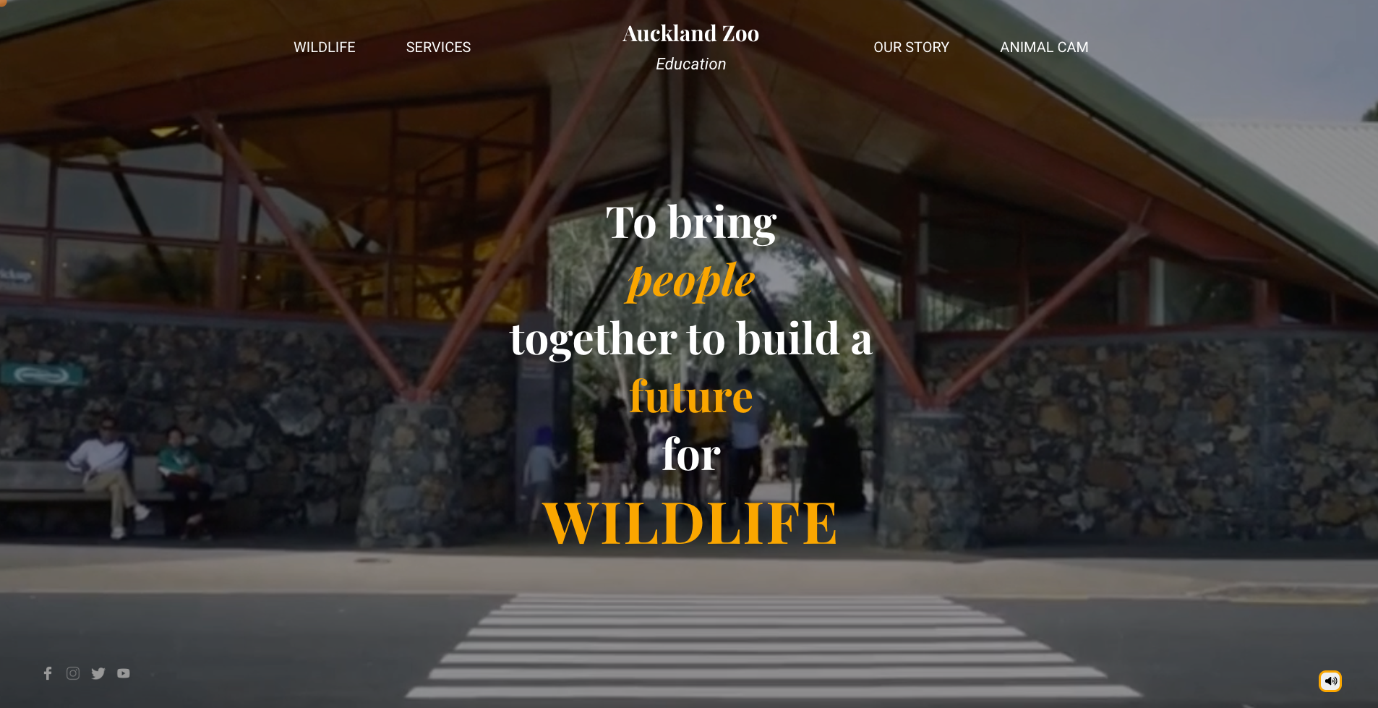


LIVE DEMO
Notes:
Loading Page: I've developed a custom loading page tailored specifically for my website. Its significance is particularly heightened due to the presence of audio elements and dynamic text effects on the homepage, which are triggered by user interactions.
This loading page is crafted to captivate users right from the outset by employing 3D and animation libraries. Through the utilization of these technologies, it delivers an immersive and interactive entrance experience for visitors.
In terms of implementation, React Hooks serve as a fundamental aspect for efficiently managing state and DOM referencing. Additionally, I've integrated specialized libraries such as @react-three/fiber for top-notch 3D rendering and @react-three/drei for seamless integration of supplementary three.js components within the webpage.
Regarding the audio aspect, upon clicking "Enter Site," users are greeted with audio upon navigating to the homepage. However, I've also provided an option for users to enter the website without triggering sound on the homepage.
Home Page:
I have taken different videos from the Auckland Zoo page and edited them together to create the video that you are currently seeing as the background to the homepage.
To ensure readability, I've overlaid the video with a transparent layer, enhancing the visibility of the mission text and navigation bar.
Moreover, I've included a speaker button that provides users with the flexibility to mute or unmute the audio on the homepage. This feature enables users to tailor their browsing experience according to their preferences, ensuring a seamless and enjoyable visit to the website.
Wildlife: The wildlife section of the website is divided into various areas found within the zoo, including the South American Rainforest, Australia Bush, South East Asia Jungle, Aotearoa, Africa Safari, and Asian Elephants.
For each of these sections, I've created dynamic homepages where users can click the "Learn More" button to access further information about the animals residing in that specific area of the zoo.
Within this section of the webpage, there's a split-screen slider that showcases an image of the animal on the left-hand side, with detailed information about the animal displayed on the right-hand side.
The information displayed for each animal is fetched from my animal data stored in MongoDB, which is initially sourced from an external API.
As I scroll through the images, the useState hook tracks the current image index, ensuring that the correct animal data is fetched and displayed for each photo shown in the slider. This allows for a seamless and informative browsing experience for users exploring the different wildlife sections of the website.
Services: In the services section, we present an array of offerings provided by our education team, including onsite and virtual education sessions, Wednesday webinars, learning from home resources, and engaging activities for kids. Each service is represented by a card component, dynamically rendered using Framer Motion's 'motion.div', which introduces captivating scaling effects synchronized with scroll progress.
From this section, users can seamlessly access booking forms tailored to the specific service requiring reservation. These forms, constructed with Bootstrap components, facilitate easy completion of mandatory fields. In the event of incomplete fields upon submission, the form highlights these areas in red and prompts users with a message stating "This field is required". Upon successful completion of all fields, the submitted data is securely collected and stored in our MongoDB database, ensuring efficient management and retrieval of booking information.
Story: This section provides an overview of the education team and their mission. I'm incorporating GSAP animation to enhance the presentation of the text. Social Media Icons
Animal Cam:
The Animal Cam component offers users an engaging and easily navigable slider, designed specifically for showcasing a variety of animal cameras. By clicking on the "Explore Camera" option, users are seamlessly redirected to the corresponding video available on the organization's YouTube channel.

Slide 9
THANKS!

